Slide 1


Slide 2

CIFAR-10 Image Classification using Deep Learning (CNNs) Advanced Machine Learning (BA-64061-001) Dr. CJ Wu Presented By Rajesh Katherasala rkathera@kent.edu

Slide 3

Abstract
This project focuses on building a Convolutional Neural Network (CNN) using the TensorFlow/Keras framework to classify images from the CIFAR-10 dataset into ten distinct categories. The model was trained on 50,000 labeled images and evaluated on a separate set of 10,000 test images. Performance assessment was carried out using key metrics such as accuracy scores, training and validation loss curves, and a confusion matrix to visualize class-wise predictions. The final model achieved an accuracy of approximately 72%, underscoring the effectiveness of CNNs in recognizing patterns and generalizing well, even with low-resolution inputs.

Slide 4
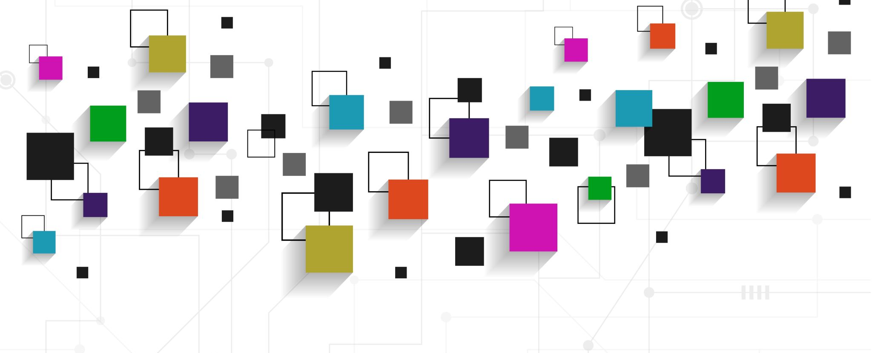
Introduction
Image classification is a foundational task in computer vision where algorithms assign categories or labels to input images based on their visual characteristics. It underpins a wide range of real-world applications, including facial recognition systems, autonomous driving technologies, object detection in surveillance, and diagnostic tools in medical imaging. Historically, traditional machine learning approaches to image classification required extensive manual feature extraction, which often failed to generalize across the diverse and complex patterns found in natural images. The emergence of deep learning, particularly Convolutional Neural Networks (CNNs), has revolutionized this domain by enabling automatic, hierarchical feature learning directly from raw pixel data. CNNs use layers of convolutions, pooling, and non-linear activations to capture both low-level features like edges and high-level representations like object shapes, greatly improving classification performance. This project focuses on designing, training, and evaluating a CNN model to classify images from the CIFAR-10 dataset, a standard benchmark containing 60,000 color images across 10 classes such as airplanes, birds, and animals. Given the small size of these images (32x32 pixels), this task presents unique challenges for feature learning. The goal is not only to build a highly accurate classifier but also to showcase CNNs’ capability to recognize intricate patterns in low-resolution images, thereby establishing a strong foundation for more advanced architectures, data augmentation strategies, and transfer learning applications in future work.

Slide 5
Problem Statement
Image classification involves assigning a label to an image based on its visual content and is a foundational task in computer vision. Traditional machine learning methods relied on manual feature engineering, which limited scalability and struggled with real-world image variability. The rise of deep learning, especially Convolutional Neural Networks (CNNs), has revolutionized this field by enabling automatic learning of hierarchical features directly from raw pixels. This project aims to design, train, and evaluate a CNN model for classifying images from the CIFAR-10 dataset—a benchmark containing 60,000 color images across ten categories such as airplanes, cats, and ships. Objectives include building a suitable CNN architecture using TensorFlow/Keras, assessing performance through accuracy metrics and confusion matrices, and identifying misclassifications. The project also explores improvements like data augmentation and transfer learning to enhance generalization and lays the groundwork for future applications on more complex datasets.

Slide 6
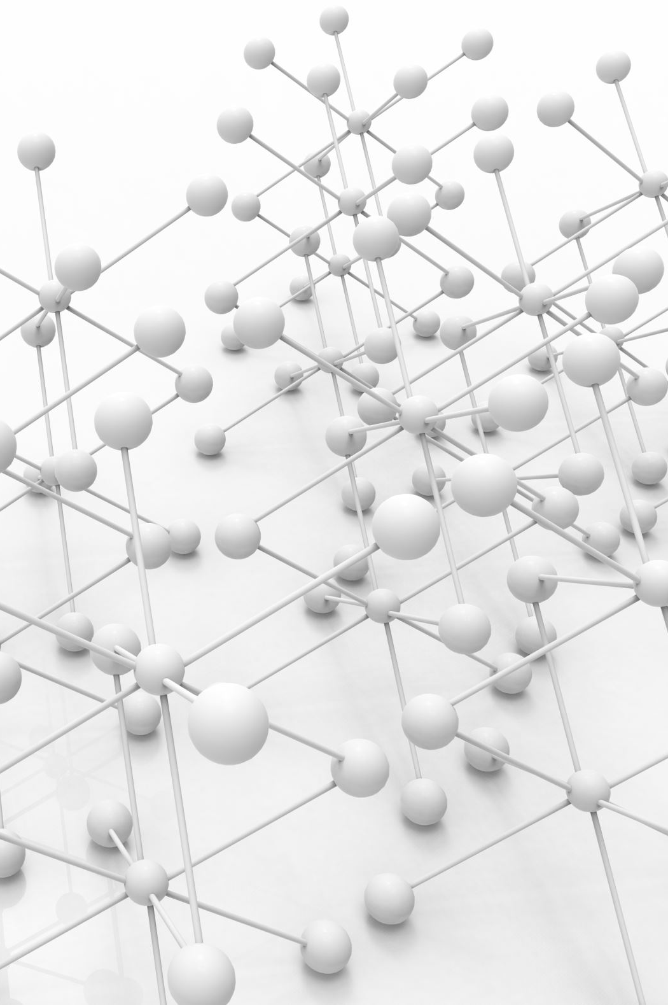
Literature Review
The field of computer vision has been significantly advanced by deep learning, particularly through the use of Convolutional Neural Networks (CNNs), which have become the standard model for image-based tasks. Early CNN architectures like LeNet-5 laid the groundwork for this approach, while AlexNet revolutionized the field by demonstrating the potential of deep CNNs in large-scale image classification. CNNs function through a hierarchy of layers—convolutional, pooling, and fully connected—which enables them to learn both low-level and high-level features from image data. Later advancements such as Residual Networks (ResNet) addressed the vanishing gradient problem in deep networks by introducing skip connections, allowing for the training of significantly deeper models. More recently, Vision Transformers (ViTs) have emerged as a competitive alternative to CNNs by modeling images as sequences of patches and applying attention mechanisms to capture global context. To enhance model performance, especially on smaller datasets like CIFAR-10, transfer learning and data augmentation have proven highly effective. However, several challenges remain in the field. Overfitting is a common issue with small datasets, and deep models are often vulnerable to adversarial inputs—subtle perturbations that lead to incorrect predictions. Additionally, training deep networks can be computationally expensive, requiring significant resources. These considerations highlight the ongoing need for robust, scalable, and interpretable deep learning solutions in computer vision.

Slide 7
Industry Applications
Convolutional Neural Networks (CNNs) have been widely adopted across industries due to their effectiveness in visual recognition tasks. In healthcare, they enable automated diagnosis from medical imaging. In transportation, CNNs support object detection in self-driving cars. Security systems use them for facial recognition, while retail leverages them for product identification and inventory control. In agriculture, they help classify crops and pests using aerial imagery. However, CNNs require large annotated datasets, are vulnerable to adversarial attacks, and lack interpretability. Future developments aim to address these issues through self-supervised learning, robust training methods, and explainable AI (XAI). These advancements will lead to more efficient, secure, and transparent deep learning models for real-world deployment.
Industry | Application
Healthcare | Automated diagnosis using medical imaging (e.g., MRI scan classification)
Transportation | Object detection and lane recognition in self-driving cars
Security | Facial recognition and surveillance systems
Retail | Automated product recognition and inventory management
Agriculture | Crop and pest classification through aerial imagery

Slide 8
Dataset & Preprocessing
This project uses the CIFAR-10 dataset, which includes 60,000 32x32 color images labeled across 10 object classes. It is split into 50,000 training and 10,000 testing samples. Images represent everyday categories like airplane, automobile, cat, dog, and ship. Before training, data was normalized (pixel values scaled from 0–255 to 0–1) to stabilize learning and improve convergence. Labels were flattened to match model input requirements. The CNN architecture consists of three convolutional blocks with ReLU activations and max pooling, followed by a flattening layer and dense layers for classification. The model was implemented using TensorFlow/Keras, optimized for learning from small image inputs.
Class Label | Description
0 | Airplane
1 | Automobile
2 | Bird
3 | Cat
4 | Dog
5 | Deer
6 | Frog
7 | Horse
8 | Ship
9 | Truck
Feature | Description
Total Samples | 60,000 images
Image Size | 32x32 pixels
Channels | 3 (Red, Green, Blue)
Classes | 10
Train/Test Split | 50,000 training / 10,000 testing
Source | Canadian Institute for Advanced Research (CIFAR)

Slide 9
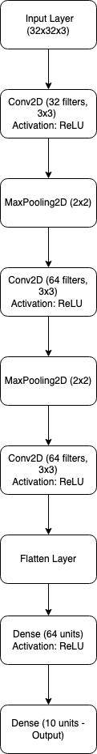
Model Architecture and Training
A CNN was developed using TensorFlow/Keras to classify CIFAR-10 images.
Architecture: 3 Conv2D + ReLU + MaxPooling blocks, followed by Flatten and Dense layers.
Input image size was 32x32x3; the output layer predicted 10 classes.
Adam optimizer (learning rate 0.001) and Sparse Categorical Crossentropy loss function were used.
50,000 images were used for training and 10,000 for testing.
Training occurred over 10 epochs, with random shuffling of the dataset before each epoch.
Layer (Type) | Output Shape | Parameters | Purpose
Input Layer | (32, 32, 3) | 0 | Raw image input
Conv2D | (30, 30, 32) | 896 | Feature extraction with 32 filters
MaxPooling2D | (15, 15, 32) | 0 | Downsampling to reduce spatial size
Conv2D | (13, 13, 64) | 18,496 | Feature extraction with 64 filters
MaxPooling2D | (6, 6, 64) | 0 | Further downsampling
Conv2D | (4, 4, 64) | 36,928 | Deeper feature extraction
Flatten | (1024) | 0 | Converts 2D features to 1D
Dense (Fully Connected) | (64) | 65,600 | Learning high-level features
Dense (Output Layer) | (10) | 650 | Final class probabilities

Slide 10
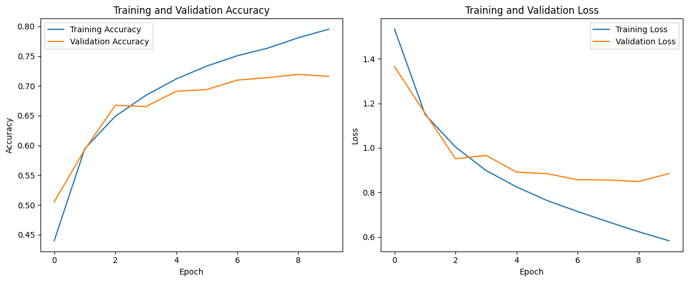
Model Results and Evaluation
Training accuracy steadily increased, reaching approximately 79%.
Validation accuracy initially improved but plateaued at around 72% after 7 epochs.
Training loss consistently decreased, indicating good learning; validation loss showed slight fluctuations.
Model performance was evaluated using training/validation curves, confusion matrix, and classification metrics.
Overall, the model demonstrated strong generalization and effective learning on small, low-resolution images.

Slide 11
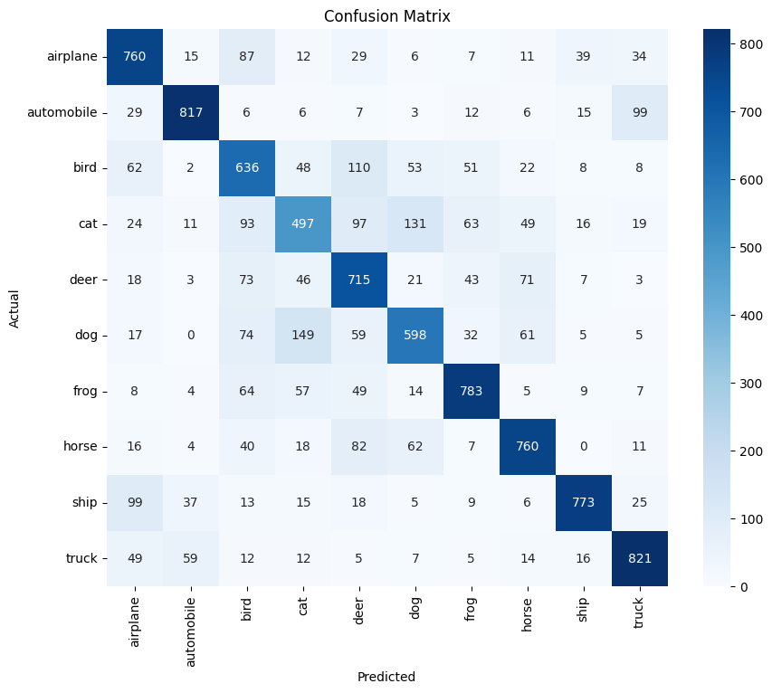
Results & Analysis
The model achieved a final test accuracy of 72.31%, correctly predicting about 7 out of 10 unseen images. The confusion matrix revealed high accuracy for classes like airplanes, cars, frogs, ships, and trucks. Misclassifications were more common between cats and dogs, and birds and airplanes, likely due to visual similarity. Deer and horses also showed some overlap in predictions. Overall misclassification rates remained low. Improvement opportunities include data augmentation and deeper CNN architectures. The classification report showed high precision and recall for airplanes, frogs, and ships. Precision was lower for visually similar classes, especially cats and dogs. The model captured strong inter-class distinctions but struggled slightly with similar features. These insights validate the model’s robustness and suggest clear paths for enhancement.

Slide 12
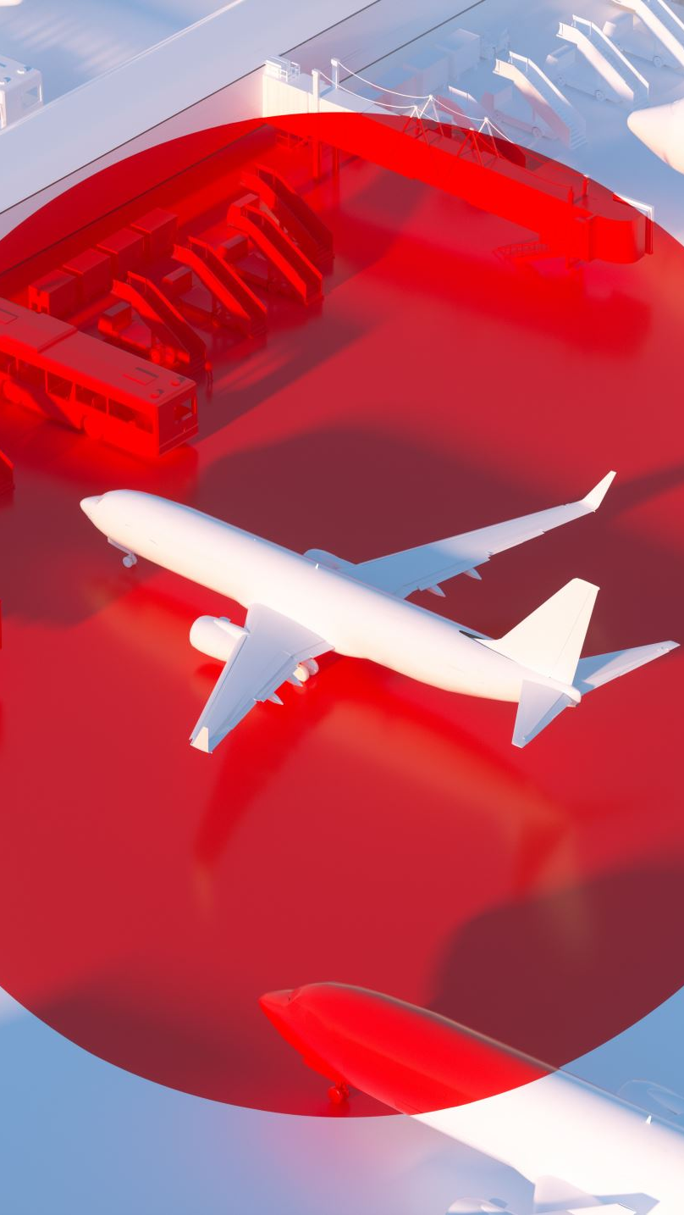
Conclusion
This project successfully implemented and evaluated a CNN for classifying CIFAR-10 images. The model achieved 72.31% test accuracy, indicating strong generalization to unseen data. Training and validation curves showed effective learning with minimal overfitting. The model performed well on distinct classes like airplanes, ships, and trucks. It struggled more with visually similar classes like cats and dogs. Improvements can include deeper architectures, data augmentation, and transfer learning. The project also explored CNN advancements and their real-world applications. Key challenges identified include robustness, data efficiency, and interpretability. The work validates CNNs as effective tools for image classification tasks. It lays the groundwork for future research in more complex visual recognition problems.

Slide 13

Thank You

